Slide 1
Planning and Scheduling
Brian Drabble
Computational Intelligence Research Laboratory
&
On Time Systems, Inc
drabble@cirl.uoregon.edu
drabble@otsys.com

Slide 2
What is Scheduling?
Allocation of resources to tasks over time that meet one or more optimization criteria.
This involves:
    determining task start and end times,
    resource assignments,
    satisfying all temporal and capacity constraints on task execution

Slide 3
Simple Scheduling Problem
T2
T1
T4
T5
Release Date
RD1
Deadline Date
DD1
T3
start (I) + duration (I) <= start (j)
resource (I) ≠ resource (j) if I≠j
RD1 <= start(I)
DD1 >= end (j)
R1
R2
T6
T7
T8
T9
Release Date
RD2
Deadline Date
DD2

Slide 4
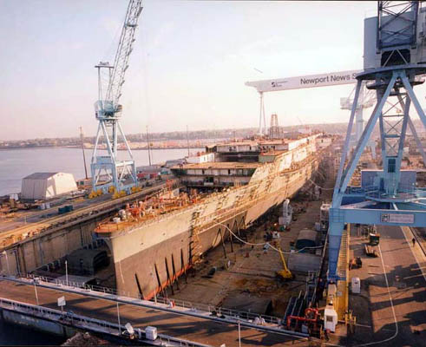
A More Complex Scheduling Problem

Slide 5
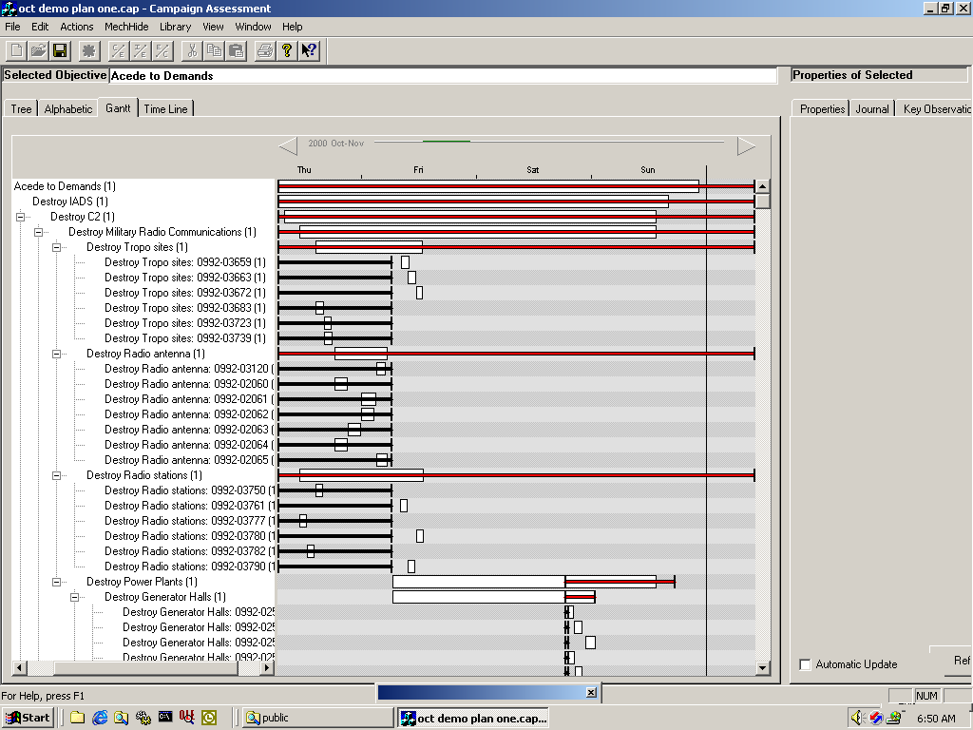
Even More Complex Problem

Slide 6
Real Domains, Real Problems
  Complexity
  Constraints
  Uncertainty
  Probabilities
  Distributed information
  Decision hierarchy
  Different domains present different challenges

Slide 7
Traditional Approaches
Simplified modeling assumptions
  assume linear usage
  assume resources kept until completion
Sub-optimal scheduling procedures
  combine human/automatic scheduling
  simple greedy allocation of resources
  inability to anticipate resource contention

Slide 8
Traditional Approaches
Inability to react to changes
  cannot react fast enough
  inability to minimize schedule changes
Lack of robustness
  brittle solutions
  maximize on one optimization criteria

Slide 9
Resources Required
Based on Early Dates
All Labor Required
by EAR dates
15
REQUIRED
AVAILABLE
10
Availability
5
0
01-MAY-95
15-MAY-95
29-MAY-95
12-JUN-95
26-JUN-95
10-JUL-95
24-JUL-95
REQUIRED
0
0
3
5
14
13
7
3
1
0
0
0
0
0
AVAILABLE
7
7
7
7
7
7
7
7
7
7
7
7
7
7
OVERLOAD
0
0
0
0
7
6
0
0
0
0
0
0
0
0
UNDERLOAD
7
7
4
2
0
0
0
4
6
7
7
7
7
7

Slide 10
Resources Required
Showing early and late dates
All Labor Required
Lates based on PROJECT FINISH
by 31-JULY-95
1
5
E
A
R
L
Y
L
A
T
E
A
V
A
I
L
A
B
L
E
1
0
Availability
5
0
-
9
5
-
9
5
-
9
5
9
5
9
5
9
5
9
5
Y
Y
Y
N
-
N
-
L
-
L
-
M
A
M
A
M
A
J
U
J
U
J
U
J
U
1
-
5
-
9
-
2
-
6
-
0
-
4
-
0
1
2
1
2
1
2
E
A
R
L
Y
0
0
3
5
1
4
1
3
7
3
1
0
0
0
0
0
L
A
T
E
0
0
0
0
0
0
0
2
4
9
1
2
1
2
6
1
A
V
A
I
L
A
B
L
E
7
7
7
7
7
7
7
7
7
7
7
7
7
7
O
V
E
R
L
O
A
D
0
0
0
0
7
6
0
0
0
0
0
0
0
0
U
N
D
E
R
L
O
A
D
7
7
4
2
0
0
0
4
6
7
7
7
7
7

Slide 11
Typical Approach
1
5
Align tasks with their early start date.
Prioritize.
Calculate day 1 resource availability.
Assign to tasks with early starts on day 1, in priority order.
Stop when resources run out.
Postpone tasks not receiving resources by one day.
Repeat for day 2, etc.
Keep postponing tasks until there are enough resources for their needs and those of higher priority tasks.
Stop postponing task when float runs out (at late start).
  Schedule it where overload would be minimal.
1
0
5
0
-

Slide 12
Resource Scheduling
Float sacrificed in
order to achieve
leveled manning.
1
5
E
A
R
L
Y
S
C
H
E
D
U
L
E
A
V
A
I
L
A
B
L
E
1
0
NEW Early Finish
11-Jul.-95 based on
resource leveling.
Availability
5
0
-
9
5
-
9
5
-
9
5
9
5
9
5
9
5
9
5
Y
Y
Y
N
-
N
-
L
-
L
-
M
A
M
A
M
A
J
U
J
U
J
U
J
U
1
-
5
-
9
-
2
-
6
-
0
-
4
-
0
1
2
1
2
1
2
E
A
R
L
Y
0
0
3
5
1
4
1
3
7
3
1
0
0
0
0
0
S
C
H
E
D
U
L
E
0
0
3
5
7
6
6
7
7
4
1
0
0
0
A
V
A
I
L
A
B
L
E
7
7
7
7
7
7
7
7
7
7
7
7
7
7
O
V
E
R
L
O
A
D
0
0
0
0
7
6
0
0
0
0
0
0
0
0
U
N
D
E
R
L
O
A
D
7
7
4
2
0
0
0
4
6
7
7
7
7
7

Slide 13
Advantages of Intelligent Systems
Higher Fidelity domain models
  accessible, interpretable, extensible, and maintainable
Ability to handle diverse constraints
  specialized and extendable heuristic algorithms
Creation of domain libraries
Managing uncertainty and probabilities
  develop schedules to the appropriate level of detail
  ability to incrementally modify/repair solutions

Slide 14
Advantages of Intelligent Systems
Hybrid approaches
  non-systematic (AI) coupled with systematic (OR)
Peer to Peer Collaboration
  “mixed-initiative” analysis and manipulation of schedules
Exception monitoring and analysis
Collaborative and distributed functionality
  late delivery of a sub-component?

Slide 15
Improvement in Savings
USAF/AMC: ~5% savings on $750M/year
Lucent: 20x larger, 20⁺% savings
CD mfr’g: 66% reduction in lateness,
40% increase in throughput
Boeing: 10% reduction in makespan,
50x scheduling speedup
Mission Planning USAF: 60% makespan reduction
1% reduction in quality
Notes:
Here’s a rough indication of the kinds of results we’ve seen on real, large-scale, industrial scheduling, and optimization problems

Slide 16
ARGOS: Overview
Domain: Shipyard assembly and repair
Context: Minimize labor costs
Developer: On Time Systems and CIRL
Status: Evaluated at Electric Boat going live in late 2002

Slide 17
Application: ARGOS shipyard assembly
Problem Inputs
  Task networks (partially ordered tasks)
  Resource classes, availability's and cross trades (welders, plumbers, etc.)
  Release times, deadlines and sub-assembly deliveries
Produce
  Assignment of resources to tasks over time
  Minimize the variation in resource levels
  Minimize undertime, overtime, hires, and fires

Slide 18
Problem Characteristics
Problem Size
  7,000 tasks per submarine and approx. 125 resource classes
  variable resource profile per task
Resource Constraints
  Precedences (SS, SF, FS, FF)
  overtime, undertime, hire, and fire costs
  interruptible tasks

Slide 19
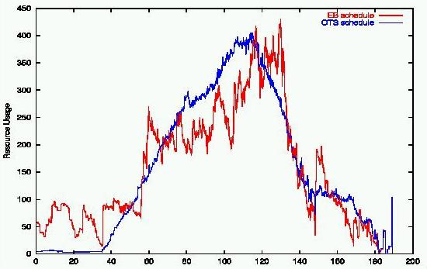
Schedule Output
Difficult to
React to
Changes
Hire and
Fire

Slide 20
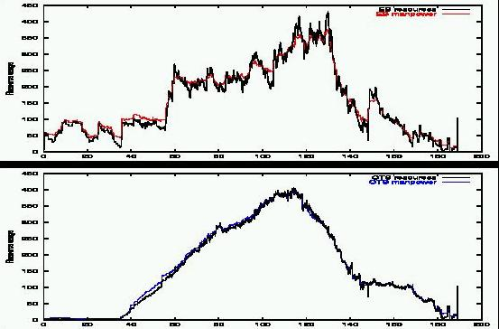
Schedule Comparison
Differences
increase costs
Smooth ramp
up and down

Slide 21
Impact: One Boat
Labor costs of existing schedule: $155M
Time to produce existing schedule: ~6 weeks
15% reduction in cost, 50x reduction in schedule development time
Iteration Time Savings
1 2 min 8.4% $13.0M
7 10 min 11.4% $17.7M
20 34 min 11.8% $18.2M
Ultimate ~24hrs 15.5% $24.0M

Slide 22
Impact: Whole Yard
All hulls, about 5 years of production
Estimated cost of existing schedule: $630M
No existing software package can deal with the yard coherently
Iteration Time Savings
1 24 min 7.8% $49M
7 60 min 10.2% $65M
20 4 hours 10.7% $68M
Ultimate 4 days 11.5% 73M

Slide 23
Extensions
Shared resources
  dry dock
  cranes
Sub-assemblies
  provided by different yards and suppliers
Repair
  dealing with new jobs

Slide 24
Schedule Pack: Background
Domain: Aircraft Assembly
Context: Minimize assembly time for wing assemblies
Developer: On Time Systems and CIRL
Status: Evaluated at Boeing

Slide 25
Application: Aircraft assembly
Problem Inputs
  Task and precedence specification
  Resource profiles and capacities
  Support resources (assembly bays and cranes)
Produce
  Assignment of resources to tasks over time
  Minimize makespan for single/multiple wings
  Reduce scheduling time from hours to minutes

Slide 26
Problem Characteristics
Problem characteristics
  ~570 tasks, 17 resources of various capacities
Resource constraints
  setup costs between operations
  exclusion areas
  reserve capacity
  union and business rules
18

Slide 27

Schedule Output
Yellow = low precedence
Pink = high precedence

Slide 28
Impact
~570 tasks, 17 resources, various capacities
  about 1 second to first solution
  about 1 minute to within 2% of best known
  about 30 minutes to best schedule known
10-15% shorter makespan than best in-house
  4 to 6 days shorter schedules (1 day production worth $200k-$1M)
2 orders of magnitude faster scheduling
  scheduler runs inside production cycle
  less need for rescheduler

Slide 29
Extensions
Multi-unit assembly
Interruptible tasks
Persistent assignments
Multiple objectives
  e.g., time to first completion, average makespan, time to completion
Fast enough to use for “what-iffing”
  discovered improved PM schedule

Slide 30
Outline of Tutorial
  Introduction and Motivating Applications
    Shipbuilding assembly
    Aircraft Manufacturing
  Intelligent Scheduling Techniques
    Rule-based Approaches
    Constraint-based Search and Heuristics
      Historical Evolution
      Constructive (CSP) Models
      Iterative Repair and Improvement Techniques
    Constraint Logic Programming
    Hybrid AI/OR Approaches

Slide 31
Outline of Tutorial
  Scheduling Systems and Architectures
    Integrating Scheduling and Control
    Mixed-Initiative Scheduling
    Distributed Frameworks
    Scheduling and Learning
  Research Directions

Slide 32
Intelligent Systems Approaches
Outline:
  Encode human level expertise as a rule base
Advantages:
  Manage the knowledge of an organization
  Portable
  Evolve and develop over time
  Develop formal ontologies and representations

Slide 33
IS Approaches: Methodology
Approach is to decompose the problem in a top down hierarchy
Each sub-task is solved by its own set of rules
IF-THEN rules identify issues to be solved
  If ISSUE = machine-center-overload and STEP = capacity analysis
  Then order should be sub-contracted.

Slide 34
IS: Approaches: Results
Applied to simple problems involving shop floor and dispatching
Expert knowledge tends to be very contextual
Useful for capturing standards procedures
Problematic in highly dynamic environments

Slide 35
Constraint-directed Search
Operations Research (OR)
  LP/IP solvers
    seem to be near the limits of their potential
Artificial Intelligence (AI)
  search-based solvers
    performance increasing dramatically
    surpassing OR techniques for many problems

Slide 36
Search-based Techniques
Systematic
  explore all possibilities
    Depth-First Search
    Limited Discrepancy Search
Nonsystematic
  explore only “promising” possibilities
    WalkSAT
    Schedule Packing

Slide 37
Heuristic Search
  A heuristics prefers some choices over others
  Search explores heuristically preferred options

Slide 38
Limited Discrepancy Search
  Better model of how heuristic search fails

Slide 39
Limited Discrepancy Search
  LDS-n deviates from heuristics exactly n times on path from root to leaf
LDS-0
LDS-1

Slide 40
Schedule Packing
  Post-processing to exploit opportunities
1
1
2
2

Slide 41
Schedule Packing
  schedule longest chains first
    starting from right
1
1
2
2
1
1
2
2

Slide 42
Schedule Packing
  repeat, starting from the left
1
1
2
2
1
1
2
2

Slide 43
Schedule Packing: Results
Successfully applied to several large scale manufacturing and assembly problems
Useful in single criterion scheduling applications (e.g. makespan)
Problems occur when handing low precedence problems

Slide 44
Schedule Packing: Demonstration
Boeing wing assembly problem
  ~570 tasks, 17 resources, various capacities
    about 1 second to first solution
    about 1 minute to within 2% of best known
    about 30 minutes to best schedule known
  10-15% shorter makespan than best in-house
    4 to 6 days shorter schedules
  2 orders of magnitude faster scheduling
    scheduler runs inside production cycle
    less need for rescheduler

Slide 45
Squeaky Wheel Optimization
Mission 1234
AAR 234
SEAD 34
Construct
Mission 4567

Slide 46
Squeaky Wheel Optimization
Analyze
“High attrition rate”
“Outside target time window”
“Low success rate”
“Not attacked”

Slide 47
Squeaky Wheel Optimization
Prioritize

Slide 48
Squeaky Wheel Optimization
Prioritize

Slide 49
Squeaky Wheel Optimization
Construct

Slide 50
Priority Space
Coupled search space
P
S
P’
S’
Priority Space
Solution Space

Slide 51
Architecture
Construct Analyze Prioritize loop
Construct
P
S
Analyze
Prioritize
P’
Construct
S’
Priority Space
Solution Space

Slide 52
Construction
Construct a solution taking each task in sequence
Construct
P
S
Analyze
Prioritize
P’
Construct
S’
Priority Space
Solution Space

Slide 53
Analysis
Assign blame problem elements, relatively simple
Construct
P
S
Analyze
Prioritize
P’
Construct
S’
Priority Space
Solution Space

Slide 54
Prioritization
Adjust priority sequence according to blame
Construct
P
S
Analyze
Prioritize
P’
Construct
S’
Priority Space
Solution Space

Slide 55
Large Coherent Moves
High priority tasks handled well lower tasks fill in.
Construct
P
S
Analyze
Prioritize
P’
Construct
S’
Priority Space
Solution Space

Slide 56
Scalability
25
% Over Best Solution
20
15
TABU
LP/IP
SWO
10
5
0
0
50
100
150
200
250
300
Number of Tasks

Slide 57
Squeaky Wheel Optimization: Results
Successfully applied to several large scale task management problems
Able to handle multiple criteria scheduling problems (e.g., makespan, lateness).
Problems occur when handling large precedence chains, where to apportion the blame?
Several potential ways of dealing with blame
  momentum
  bottleneck analysis

Slide 58
Squeaky Wheel Optimization: Demonstration
Lucent Fiber-optic cable assembly problem
  300 cables to be constructed
  12 different assembly lines with different capabilities and speeds
  Minimize the set-up between tasks and minimize the overall lateness of the schedule
  Handles problems 20x larger than existing systems and is 10% cheaper
  Handles schedule updates on the fly

Slide 59
Basic CSP Scheduling
Relies on:
  modular constraint definition
  active inference on constraint conflicts in response to new/changed decisions
Three basic steps to algorithm
  constraint propagation
  heuristic and search strategies
  handling conflicts

Slide 60
Basic Definition of a CSP
Given a triple {V,D,C}, where
  V = set of decision variables
  D = set of domains for variables in V
  C = set of constraints on the values of variables in V
Find a consistent assignment of values to all variables in V

Slide 61
A Basic CSP Procedure
Step1.
  Propagate constraints to establish the current set v_{d} of feasible values for each unassigned variable d
Step 2.
  If v_{d} = Ø for any variable d, backtrack
Step 3.
  If no unassigned variables or no consistent assignments for all variables, quit;

Slide 62
A Basic CSP Procedure
Step 4.
  Select an unassigned variable d to assign
Step 5.
  Select a value from v_{d} to assign to d.
Step 6.
  Go to step 1

Slide 63
A Basic CSP Procedure
This is not as simple as it appears
  Step 2. Backtrack: where was the mistake made? and what can we learn for the future?
  Step 4. Select a variable: there could be thousands
  Step 5: Select a value for the domain: how should this affect the other variables?

Slide 64
Constraint Propagation
Twofold Objective:
  Prune the search space of unreachable assignments
  Identify possible constraint violations and thus potential dead ends

Slide 65
Constraint Propagation Terminology
K-consistency guarantees that any locally consistent instantiation of (K-1) variables is extensible to any K-th variable
Worst-Case Complexity: Chances of selecting incompatible assignments decrease for larger K, but enforcing K-consistency is (in general) exponential in K
Forward Checking: partial arc-consistency only involving constraints between an instantiated variable and a non-instantiated one

Slide 66
Formulating Scheduling Problems as CSPs
Two basic approaches
  “Fixed times” model
    Find a consistent assignment of start times to activities
  Disjunctive graph model
    Post sufficient additional precedence constraints between pairs of activities to eliminate resource contention

Slide 67
The PCP Constraint Satisfaction Scheduling Model
  Constraint satisfaction search in the space of ordering decisions
    variables - Ordering(i,j,R) for operations i and j contending for resource R
    values - i before j, j before i
  Constraint posting and propagation in the underlying temporal constraint network (time points and distances)

Slide 68
General Temporal Constraint Network (GTCN) Models
A GTCN [Meiri91] consists of
  A set of variables (nodes) which represent temporal objects - time points or intervals
  A set of constraints (arcs) on the variables:
Constraints can be
  Qualitative
    interval-to-interval relations - e.g., Int1 before Int2
    point-to-point relations - e.g., Point1 < Point2
    point-to-interval relations - e.g., Point1 starts Int1

Slide 69
General Temporal Constraint Network (GTCN) Models
Constraints can be
  Quantitative
    sets of intervals that constrain the distance between 2 points - e.g., Point1 {[10,20]} Point2

Slide 70
Solving a GTCN
A GTCN is consistent if there is an assignment of values to all variables that satisfies all constraints.
A GTCN with no disjunctive constraints defines a “Simple Temporal Problem” (STP) [Dechter91]
  solvable by translation to edge-weighted graph of time points (distance graph) and Floyd-Warshall all-pairs shortest path algorithm

Slide 71
Solving a GTCN
Basic Solution Procedure
  enumerate all possible labelings of arcs in the GTCN and solve each corresponding STP
  can increase efficiency by defining a backtracking search over a meta-CSP network, where
      variables = arcs that can be labeled in more than one way
      values = possible arc labelings

Slide 72
PCP Scheduling Model
Augments basic GTCN solution procedure to incorporate simple analysis of sequencing flexibility
Analysis utilized in 2 ways:
  Dominance Conditions - to detect unconditional decisions and promote early pruning of search alternatives
  Variable and Value Ordering Heuristics - for ordering and determining the decisions that remain to be made

Slide 73
Basic PCP Search Procedure
Input problem
Check dominance conditions
and classify remaining
Ordering_{i,j} decisions
Compute sp_{i,j} and sp_{j,i} for
each unordered pair (O_{i}, O_{j})
yes
Any
Case 1 or 2
?
Post new ordering relation
no
For selected Ordering_{ij},
if bsp_{ij} ≥ bsp_{ji} choose i -> j
else choose j->i
yes
Any
Case 4
?
no
Any
Case 3
?
no
yes
Compute w_{ij}=min(bsp_{ij}, bsp_{ji}) for
each remaining Ordering_{ij}, and
choose Ordering_{ij} with minimum w_{ij}
Solution found
Backtrack

Slide 74
Minimizing Schedule “Makespan”
Assumption:
  establish lower/upper bounds on overall schedule end
  repeatedly apply PCP procedure to find the best solution within these bounds
Bounds:
  lower: ignore resource constraints
  upper: simple dispatch-based algorithm

Slide 75
Conflict Handling
Systematic:
  Chronological Backtracking
  Backjumping
  Constraint Recording
  Dependency-directed backtracking = backjumping + constraint recording
Non-systematic:
  Heuristic Backtracking
  Repair Approaches
  Re-Starting

Slide 76
Re-starting Frameworks
Deterministic - e.g., Limited Discrepancy Search
  Systematically deviate from search heuristics on successive searches
  First follow heuristics on all decisions, then explore all paths that deviate once, then explore all paths that deviate twice, and so on
Stochastic Sampling - e.g., Random PCP
  Stochastic variable and value ordering heuristics
  Vary “noise” according to heuristics belief

Slide 77
Repair Heuristics
Assumption: Can the problem be fixed locally without undoing the current schedule.
Min-conflict heuristics: select a conflicting variable and assign it a value that minimizes the number of remaining conflicts.
Contextual repair heuristics: select a heuristics based on the reason for the conflict (capacity, precedence, etc.).

Slide 78
Basic Iterative Search Framework
Step 1.
  Generate initial schedule(s)
Step 2.
  Loop until exit criteria met
    a. apply neighborhood search operators to current solution(s) to generate new candidate solution(s)
    b. evaluate new candidate solutions
    c. select new (set of) current schedule(s)

Slide 79
Iterative Scheduling Techniques
Iterative Repair
Simulated Annealing (SA)
Genetic Algorithms (GAs)
Tabu Search (TS)
Neural Net Approaches (NN)

Slide 80
Critical Design Issues
Generation of new solutions
  Definition of search neighborhood
  Solution representation to facilitate productive search
Enforcing complex constraints
  Penalty functions
  Solution post-processor (e.g., simulator)
Termination conditions

Slide 81
Performance Characteristics
Demonstrated ability to produce near-optimal schedules on classical benchmark problems if given enough time
Examples of strong performance on real world problems
Retention of best solution found so far yields “anytime” procedure

Slide 82
Iterative Repair Framework
Constraints
  requirements on the final solution
Conflicts
  instances of ways in which constraints may be violated
Repair Method
  algorithm for making schedule modification to remove conflict

Slide 83
Constraint Logic Programming
Combines the declarative aspects of logic programming with the efficiency of constraint solving techniques
Extends Prolog-like logic languages by introducing new computation domains, e.g.:
  finite domains: constraint propagation (mainly forward checking)
  boolean terms: equation solving in Boolean algebra
  linear rational terms: Simplex-like algorithms

Slide 84
Constraint Logic Programming
Successfully applied to a variety of not too complex scheduling problems (e.g. car sequencing problem)
CLP packages: CHIP, PROLOG III, CLP(R), etc.

Slide 85
OR-based Approaches
Operations Research (OR) offers a number of techniques for solving specialized classes of problems (e.g., linear programming, integer linear programming, mixed integer programming).
Problems occur in trying to make the problem fit into one of these frameworks.
OR techniques can often be used to solve subproblems or larger scheduling problems.

Slide 86
Schedule Optimization
Often schedules have hard and soft (preference) constraints
  preferences on task ordering
  preferences on start times
  preferences on optimization criteria
Ordering on the relative merit of schedules
Desire to find “best possible” schedule
Need to maximize the objective function(s)

Slide 87
Scheduling as Optimization
One approach is to define an objective function over possible schedules.
Search now tries to optimize the score of this function.
Search moves can be evaluated in terms of how well they improve this score.
Standard search methods can be used
  branch-and-bound
  simulated annealing

Slide 88
Sample Optimization Framework
Scoring Item
  Improvement Methods
preference over # of occurrences of activity type
  add/delete activities of type
preference over resource value
  add/delete users/replenishers of resource
preference over state value
  add/delete appropriate state changers
preference over start time of activity
  move activity
...

Slide 89
“Spreadsheet-like” Scheduling Models
User directly manipulates decisions and/or constraints, and system indicates consequences
Simple Constraint-based Frameworks
  user interactively makes decisions; system provides deductive constraint management

Slide 90
DITOPS/OZONE Technology
OZONE Scheduling Framework
  Consolidated scheduling model (ontology) based on multiple application efforts
    Manufacturing, Strategic deployment, Medical evacuation planning, AMC “Barrel Master” scheduling (CAMPS)
  Software architecture that facilitates customization

Slide 91
DITOPS/OZONE Technology
DITOPS Transportation Scheduler
  Continuous scheduling process
  What-if analysis of alternatives
  Graphical visualization and manipulation of schedules
  Different levels of automated/semi-automated decision-making

Slide 92
Collaborative Scheduling
Flexible manipulation of plans and schedules
Schedule scope?
  When can we complete all activities?
  What levels of resources are needed to meet time constraints?
  What is the latest possible start date of overall plan?
Integration with other data sources
  Navigation operations
  MRP-III systems
  Exploration coordinated with briefing tools

Slide 93
Distributed Scheduling
Requires partitioning of knowledge and decision-making
  responsiveness requires localized decision-making
  different decisions and decision-making time over different time scales
  manufacturing systems and organizations are governed by multiple decision-makers

Slide 94
Distributed Scheduling
Issues
  How do you partition responsibility?
  How do you partition system knowledge?
  How do you coordinate decision-making?

Slide 95
Agent-based Approaches
Assumption:
  reduction in problem complexity
    specification of local problem solving
    overall solution emerges from agent interactions
  better suited to dynamic events
  components can be replaced and updated as needed

Slide 96
Agent-based Approaches
Problems:
  negotiation overhead
    what is communicated, when and what assumptions are made?
  conflict resolution between agents
    who decides on the “right” answer?
  achieving and maintaining global coherence
    too much autonomy and you have chaos!!

Slide 97
Machine Learning Opportunities
Selection of Heuristics for control points
Determination of applicability conditions for specific heuristic methods
Reinforcement Learning appropriate for these

Slide 98
Adaptive Problem Solving
Use statistical analysis to evaluate performance of various combinations of heuristics (Gratch & Chien 1996 JAIR)
Statistical techniques estimate unknown distribution = performance of scheduler using particular heuristics
Learn best set by comparisons

Slide 99
LR-26 Prototype for DSN Scheduling
Uses refinement search in constraint space
Choice points include:
  constraint to attack (track1 or track3 or...track7)
  method of solving constraint (generates children)
  method of ordering children
Designer of scheduler (Bell) chose initial settings via analysis of, experimentation with domain

Slide 100
Integrating Planning and Scheduling
Integrating planning and scheduling systems raises many issues:
  how are the plans specified to the scheduler?
    partially ordered, totally ordered?
  how does the planner integrate scheduler feedback
    I do not have enough welding machines?
  how does the scheduler understand the needs of the planner?
    I can hit 4 out of 5 targets is that enough?

Slide 101
Integrating Planning and Scheduling
Dynamic Execution Order Scheduler (DEOS) was developed to handle these issues.
  planner specifies the “effects” to be achieved at each level in the hierarchy
  DEOS chooses the actions that best meet those effects with the framework
  actions are selected to maximize the overall effects of the plan
  feedback is described in terms of changes to an effect (e.g. change deadline, level of effect, etc.)

Slide 102
Integrating Planning and Scheduling
Demonstration
  Campaign Assessment Tool (CAT)
  Joint Targeting Tool (JTT)
  DEOS
Develop an air campaign schedule for 600 targets and 100 aircraft over a 5 day period.
DEOS develops solutions in seconds that existing USAF systems take hours to produce.

Slide 103
Future Work
Areas of scheduling which need the most attention (and offer great Ph.D. opportunities!!)
  Robustness
  Distributed scheduling
  Common task description

Slide 104
Penalty Box Scheduling
Sub-set of the tasks with higher probability of success.
  90% probability of destroying 90% of the targets?
  96% probability of destroying 75% of the targets?
Inability to resource leads to a task “squeak”
Blame score related to user priority and “uniqueness”
Reduce the target percentage until no significant improvement is found

Slide 105
Semi-Flexible Constraints
The time constraints provided by the users tended to be ad-hoc and imprecise
  heuristics based on sortie rate, no of targets, etc.
  this is what we did last time so it must be right!!
Not a preference
  this is what I want until you can prove otherwise!!
Two algorithms were investigated
  pointer-based
  ripple-based

Slide 106
Semi-Flexible Constraints: Pointer-based
“Attack the IAD before power system”
IAD-E
IAD-L
Power-E
Power-L
0
3000
6000
Time (Minutes)

Slide 107
Semi-Flexible Constraints: Pointer-based
“Attack the IAD before power system”
IAD-E
IAD-L
Power-E
Power-L
0
3000
6000
Time (Minutes)

Slide 108
Semi-Flexible Constraints: Pointer-based
“Attack the IAD before power system”
IAD-E
IAD-L
Power-E
Power-L
0
3000
6000
Time (Minutes)

Slide 109
Semi-Flexible Constraints: Ripple-based
“Attack the IAD before power system”
IAD-E
IAD-L
Power-E
Power-L
0
3000
6000
Time (Minutes)

Slide 110
Semi-Flexible Constraints: Ripple-based
“Attack the IAD before power system”
IAD-E
Power-E
IAD-L
Power-L
0
3000
6000
Time (Minutes)

Slide 111
Semi-Flexible Constraints: Ripple-based
“Attack the IAD before power system”
IAD-E
IAD-L
Power-E
Power-L
0
3000
6000
Time (Minutes)

Slide 112
Common Task Model
Plan
Ready
Fly
Execute
Recover
“Drop 120, MK-84s from 3 B-52s at location X,Y at 22.00 on D+5”
30 mins
20 mins
40 mins
5 mins
60mins
P
R
F
E
R
Bomb Depot
P
R
F
E
R
SEAD Flight
P
R
F
E
R
AAR
P
R
F
E
R
B-52 Flight
P
R
F
E
R
AWACS
P
R
F
E
R
Weapon Loader
P
R
F
E
R
CAP Flight
Information & Control

Slide 113
Example Problem
The AWACS aborts on take off!
P
R
F
E
R
Bomb Depot
P
R
F
E
R
SEAD Flight
P
R
F
E
R
AAR
P
R
F
E
R
B-52 Flight
P
R
F
E
R
AWACS
P
R
F
E
R
Weapon Loader
P
R
F
E
R
CAP Flight

Slide 114
Research Trends and Directions
  Finite-capacity scheduling under more complex constraints and increased problem dimensions
    subcontracting, overtime, lot splitting, inventory, etc.
    undertime, overtime, RIFs
  Integrated planning and scheduling
  Mixed-initiative frameworks
  Management of uncertainty (proactive and reactive)

Slide 115
Research Trends and Directions
  Autonomous agent architectures and distributed production management
  Integration of machine learning capabilities
  Wilder scope of applications
        analysis of supplier/buyer protocols & tradeoffs
        integration of strategic & tactical decision-making
        enterprise integration

